Slide 1
Public Diplomacy during Pandemic Times: The ‘Taiwan Can Help’ Campaign in Latin America
Fabricio A. Fonseca, Ph.D.
Tamkang University
The 18th Annual Conference of European Association of Taiwan Studies
April 15, 2021

Slide 2
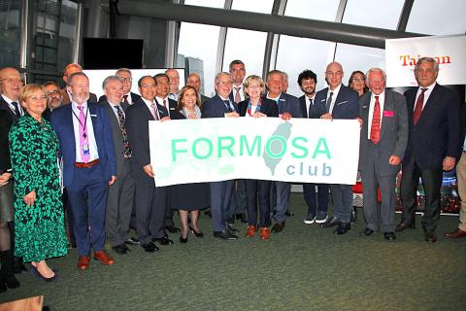
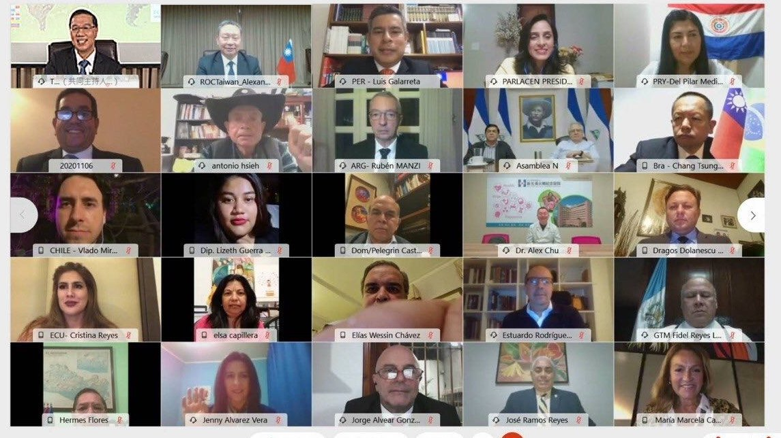
Public and Parliamentary Diplomacy
Public Diplomacy
“Instruments used by states, associations of states, and some sub-state and non-state actors to understand cultures, attitudes and behavior; to build and manage relationships; and to influence thoughts and mobilize actions to advance their interests and values” (Gregory, 2011: 353)
Parliamentary Diplomacy
International activities and actions performed by members of parliaments or legislative bodies, either with other fellow parliamentarians or with public or semi-public actors representing other states
Taiwan’s Parliamentary Diplomacy
Historical experience with the US and the EU
Increasing experience in Latin America
The ‘Formosa Club’
CNA
Twitter, @MOFA_Taiwan

Slide 3
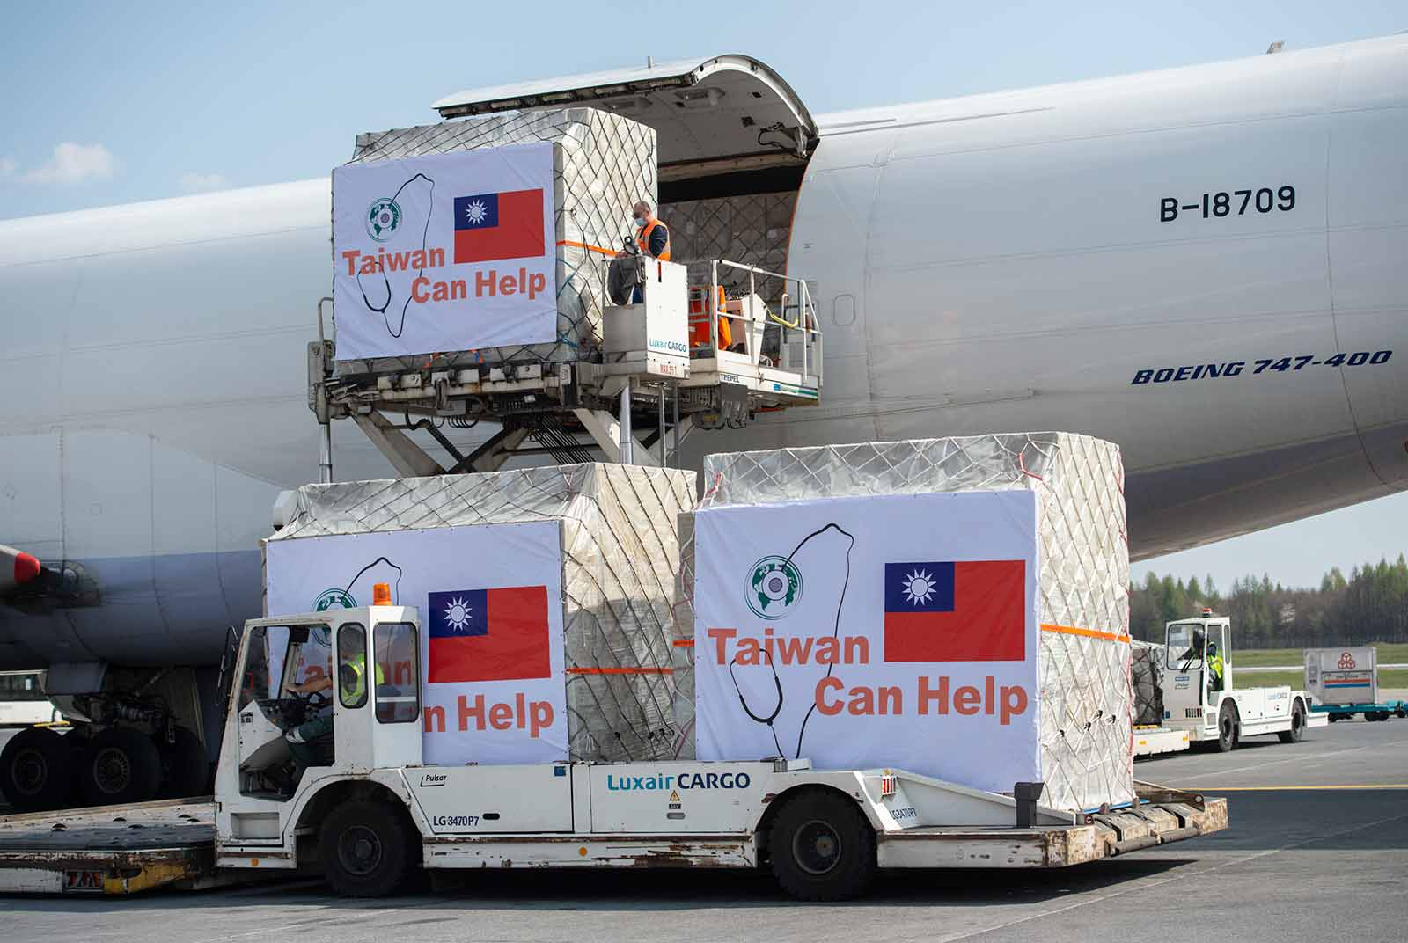
COVID-19 and ‘Taiwan Can Help’
Taiwan’s effective response to the pandemic
The ‘Taiwan Can Help, and Taiwan Is Helping’ campaign
Donation of groceries and medical supplies
The implementation of ‘Mask Diplomacy’
Rationing and state-led efforts in mask production
The United States and Europe as preferred destinations
Expansion of the TCH campaign to Latin America
Preference to ‘allied countries’
Donations to other friendly nations
The case of Mexico
Official Website EU
Twitter, @TaiwanInSweden

Slide 4
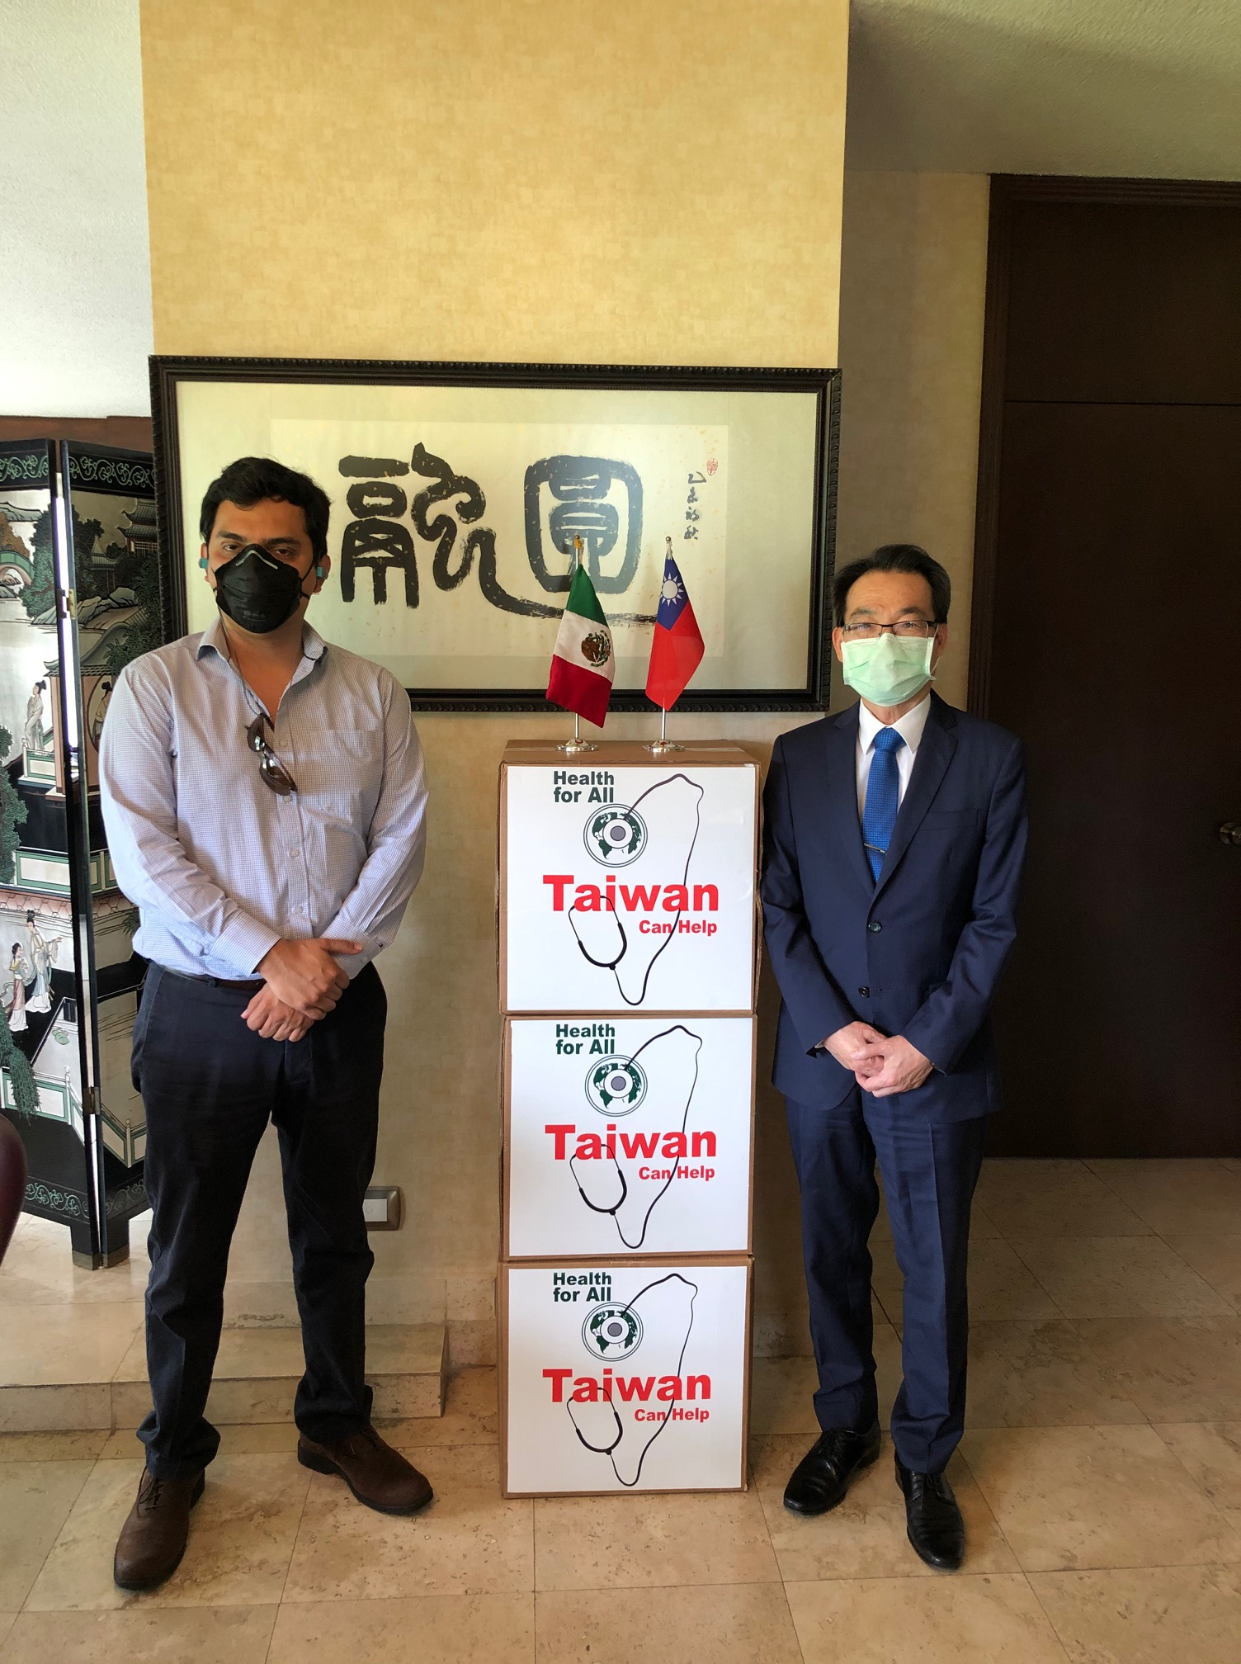
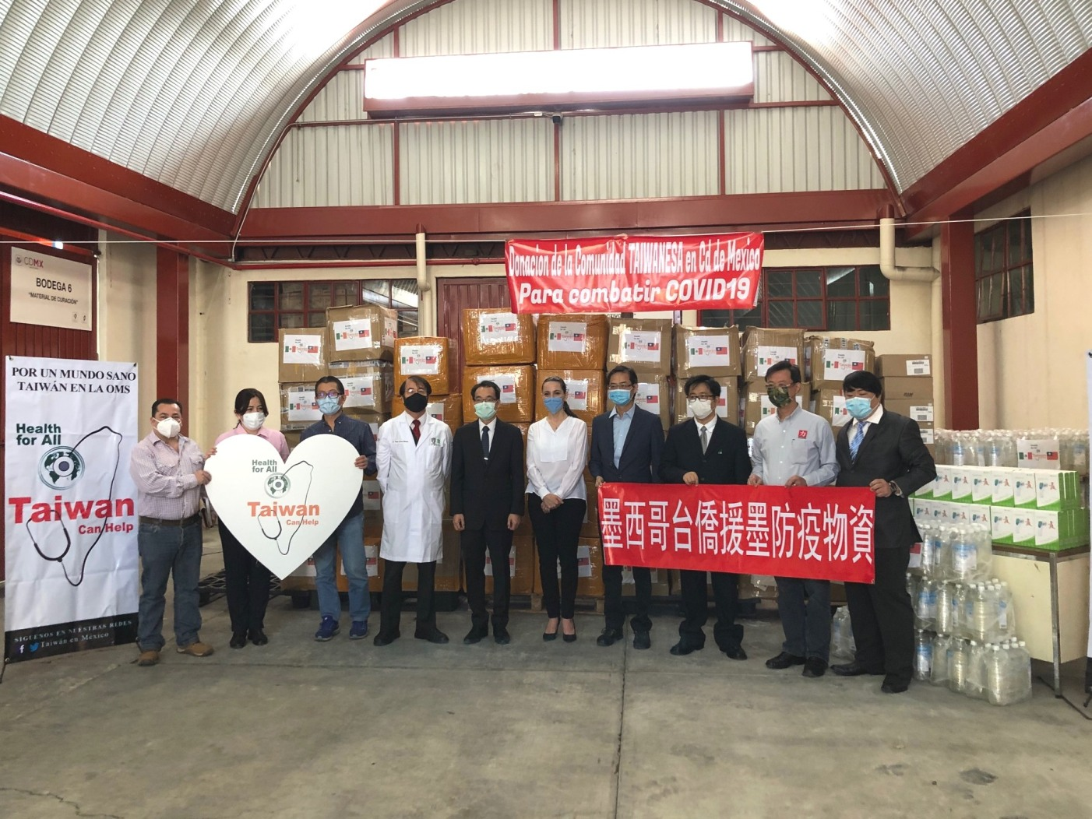
‘Taiwan Can Help’ in Mexico
Food baskets
Masks
15 cooperation projects
12 federal deputies
2 senators
1 state lawmaker in Mexico City
Around 8,500 grocery boxes
22 cooperation projects
20 federal deputies
1 senator
1 state lawmaker in Mexico City
Approx. 120 thousand masks
The “Taiwan Friendship Group”
Lawmakers from different states, parties and ideologies
Preference for legislators from the official party
Facebook, TaiwanenMexico
Facebook, TaiwanenMexico

Slide 5
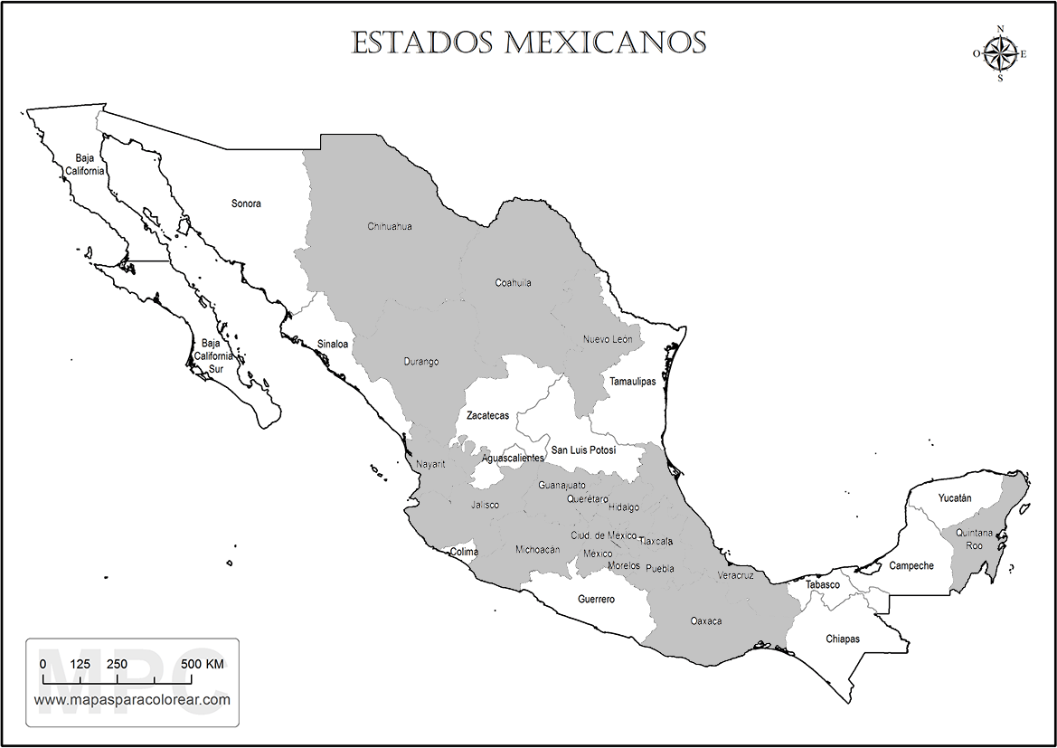
‘Taiwan Can Help’ in Mexico
States in Mexico where lawmakers cooperated with TECRO
Author’s elaboration using a template from mapasparacolorear.com

Slide 6
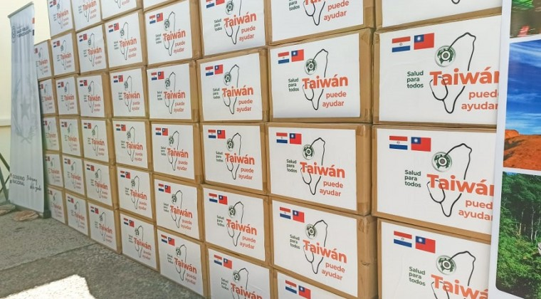
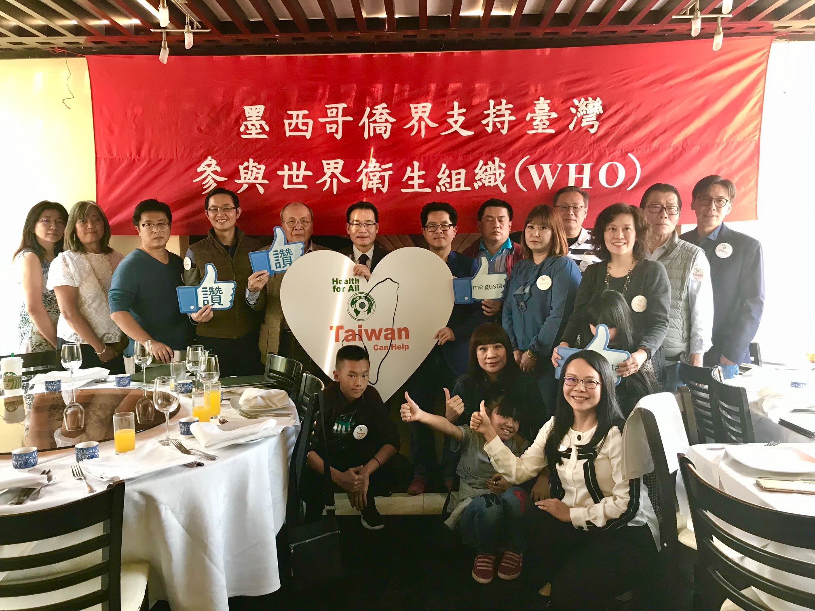
Concluding remarks
Taiwan’s effective response as an opportunity to increase its international visibility
Combination of public diplomacy instruments and parliamentary diplomacy to carry out ‘Taiwan Can Help’ campaign in Latin America
The case of Mexico as an example of those instruments
Taipei’s preference for cooperation with counterparts in the US and the EU
New challenges posed by the ongoing stage of the pandemic and the surging demand for vaccines
The case of Paraguay
How sustainable is this campaign?
aldovazquez.com
Facebook, TaiwanenMexico

