Slide 1
Between Retribution and Restoration
Contextualising Transitional Justice Legislation in Post-Transition Slovakia and Taiwan
Dominika Remžová, MA Taiwan Studies, SOAS

Slide 2
Positioning within broader literature - contextualising the difference in time and scope - adaptation of frameworks developed for intra-regional analysis of transitional justice in Central and Eastern Europe to fit the inter-regional analysis of Slovakia and Taiwan - focus on political-historical analysis and the question of why
Research questions
Which factors do best explain the difference in Slovakia’s and Taiwan’s transitional justice legislation?
Why did neither Slovakia nor Taiwan pursue retributive justice under their 1st democratically elected legislatures?
What is the role of time in the pursuit of transitional justice?

Slide 3
Country cases
Commonality | Slovakia | Taiwan
Periods/events (re)addressed by transitional justice | Clerical Fascist period under the 1st Slovak Republic (1939-1945) Communist period under the 4th Czechoslovak Republic (1948-1989) | Japanese colonial period (1895-1945) 228 Incident (1947) White Terror period (1949-1987)
Duration of the latter authoritarian period | Communism 1948-1989 | Martial law 1949-1987
Wave of democratic transition | Third wave | Third wave
Post-transition* political elites *referring to the period prior to the 1st change of ruling parties | Government and legislature dominated by former communists (HZDS*) * Hnutie za demokratické Slovensko or Movement for Democratic Slovakia | Government and legislature dominated by former authoritarian party (KMT)
Dominant post-transition cleavage | National sovereignty vis-à-vis a ‘stronger’ neighbour Nationality | National sovereignty vis-à-vis a ‘stronger’ neighbour Ethnicity
Notes:
- Slovakia’s 3rd historical source of injustice is the 3rd Czechoslovak Republic (1945-1948), but this period is not addressed by transitional justice

Slide 4
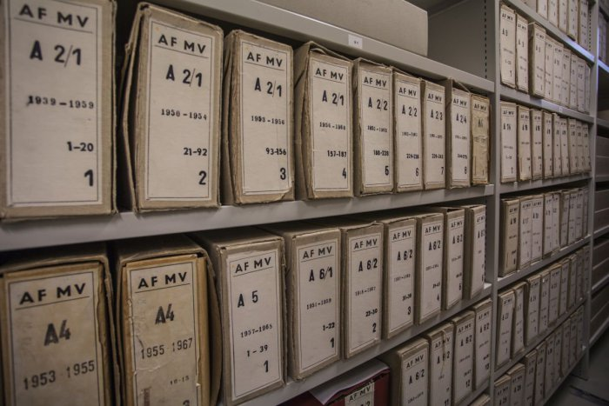
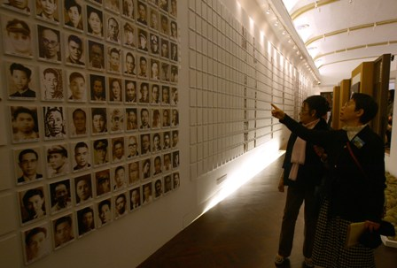
Phases of transitional justice legislation
Czechoslovakia pre-1992 legislative election (1990-1992)
combination of restorative and retributive justice
Taiwan pre-1992 legislative election (1989-1992)
amnesty/amnesia
Slovakia under HZDS: Narrow coalition of Mečiar (1992-1998)
limited restorative justice or amnesty/amnesia?
Taiwan under KMT: Lee’s administration (1992-2000)
restorative justice
Slovakia after HZDS: Broad coalition of Dzurinda (1998-2006)
combination of restorative and retributive justice
Taiwan under DPP: Tsai’s administration (2016-)
combination of restorative and retributive justice
Notes:
axis ranging from restorative (victim-centred) to retributive (perpetrator-centred) justice
Venn diagram of retribution (prosecute and punish), restoration and amnesty/amnesia (forgive and forget)
Taiwan could be classified as having limited restorative justice if the 1st phase was pushed back to 1987
both Taiwan and Slovakia had limited retributive justice during the 3rd phase

Slide 5
Methodology and framework (1)
Adapted politics of the past framework
authoritarian regime’s pre-history
nature of the authoritarian regime
nature of transition
Adapted politics of the present framework
institutional design, elite configuration and citizen-party linkages
role of civil society
international context
historical legacies explain timing and scope of transitional justice legislation during phases 1 and 2, whilst institutions and contemporary domestic and international contexts are relevant for all 3 phases
the lack of retributive justice under Slovakia’s and Taiwan’s 1st democratically elected legislatures (phase 2) is best explained by the combination of all factors
Notes:
- focus on top-down factors to explain 2nd phase

Slide 6
Methodology and framework (2) Top-down approach
Authoritarian regime’s pre-history
Previous democratic experience: existence/absence of elections
Existence/absence of political pluralism: ideological orientation of political organisations
Economic development: degree of industrialisation
Nature of the authoritarian regime
Regime type: bureaucratic-authoritarian/national-accommodative/patrimonial (Kitschelt 1999)
Regime’s use of repression/co-optation: security forces’ methods and degree of infiltration
Opposition’s use of exit/voice: options of emigration/political organisation (Moran 1994)
Economic and social development: growth and equality

Slide 7
Methodology and framework (3) Top-down approach
Nature of transition
Transition type: replacement/transplacement/transformation (Huntington 1991)
Composition and ideological orientation of new elites
Prevalence of reformists/non-reformists within the old elites
Legitimacy of the old regime
Institutional design, elite configuration and citizen-party linkages
Power balance between executive and legislative bodies
Prevalence of old/new elites in the executive and legislative bodies
Dominant cleavage: socio-economic/ethno-cultural
Legitimacy of the new regime
Notes:
- legitimacy of the old regime is linked to the nature of the authoritarian regime, whereas legitimacy of the new regime relates to the comparitive improvement within the new regime as opposed to the old regime

Slide 8
Applying the framework (1)
Factor | Slovakia | Taiwan
Authoritarian regime’s pre-history Previous democratic experience Existence of political pluralism and abundance of competing models of socio-economic modernisation Previous experience with industrialised capitalism all are conducive to retribution | 1st and 3rd Czechoslovak Republics (1918-1938, 1945-1948) Universal suffrage and frequent elections Socialist, burgeois, Christian and nationalist parties, with the former two being stronger in the Czech part and the latter in the Slovak part Czech part highly industrialised, Slovak part predominantly agrarian | Japanese colonisation (1895-1945) Restricted form of local autonomy including municipal council elections since 1935 Nationalist political organisations Significant economic growth yet still mostly agrarian at the end
Nature of the authoritarian regime Bureaucratic authoritarian regime More repressive overall, late repression in particular No space for exit/voice strategies History of poor economic performance all are conducive to retribution | Czech part bureaucratic authoritarian, Slovak part between national-accommodative and patrimonial regimes Slovak part more repressive before Prague Spring (most in 1950s) and less repressive during and after the normalisation period of 1970s Bigger space for voice in the Slovak part Better economic perfomance in the Slovak part from 1970s onwards (best in 1980s) | Between national-accommodative and patrimonial regimes Most repressive during 1950s but less repressive after 1970s (with the exception of the Kaohsiung Incident) No space for voice under Chiang Kai-shek, bigger space for voice under Chiang Ching-kuo Taiwan miracle in 1960s and growth with equity (Asian tiger)
Notes:
- Taiwan as a quasi-monolithic regime (Kong 2004)

Slide 9
Applying the framework (2)
Factor | Slovakia | Taiwan
Nature of transition Replacement Prevalence of economically liberal technocrats and internal exiles who did not voice their dissent Prevalence of non-reformists Old regime seen as illegitimate all are conducive to retribution | Czech replacement, Slovak transplacement Slovak part passive socially conservative internal exiles as well as reformed communists-turned-nationalists Prevalence of reformist old elites that renewed themselves under new party labels in the Slovak part Old regime seen as more legitimate by Slovaks | Transformation Active socially liberal dissidents Prevalence of reformist old elites (Chiang Ching-kuo initiated taiwanisation and recruitment of benshengren into KMT) Old regime seen as legitimate by significant portions of the population
Institutions, elites and cleavages Stronger parliamentary systems and programmatic appeals Prevalence of new elites with no prior links to the authoritarian regime Worsening socio-economic conditions and a lack of ethno-cultural conflict (real or imagined) New regime seen as more legitimate than the old regime all are conducive to retribution | Parliamentary system but more personalised appeals HZDS-led government and parliamentary majority Politicisation of an imagined ethno-cultural conflict to promote ethnic animosity, which became the dominant cleavage New regime seen as more illegitimate than the old regime | Semi-presidential system but more programmatic appeals KMT government and parliamentary majority + movement of local politicians implicated in clientelist networks into national arena Politicisation of a real ethno-cultural conflict to promote ethnic reconciliation (Lee Teng-hui’s civic nationalism), which became the dominant cleavage New regime seen as more legitimate
Notes:
Taiwan as a quasi-monolithic regime (Kong 2004)
legitimacy of the old regime: Lack of calls for decommunisation and pursuit of transitional justice in both Slovakia and Taiwan (regime seen as legitimate by waishengren as well as benshengren who collaborated with the old regime through patron-client networks)

Slide 10
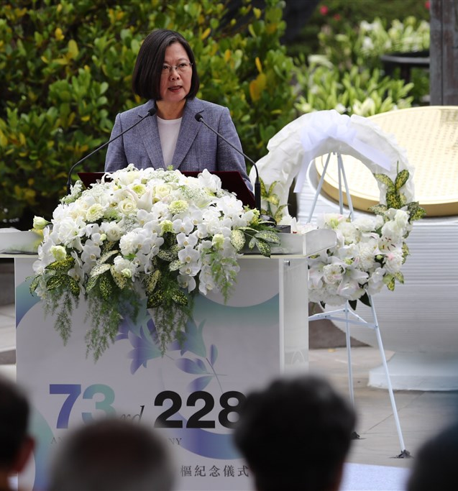
Concluding remarks
The lack of retributive justice under Slovakia’s and Taiwan’s 1st democratically elected legislatures can be explained by a combination of politics of the past and politics of the present factors
All the factors are interconnected and therefore even though the authoritarian regime’s pre-history may not be a major determinant for the lack of retributive justice, it should still be considered due to its influence on the nature of the authoritarian regime
Politics of the past is particularly useful when it comes to differences between Slovakia and Czechia, as well as Taiwan and South Korea
Despite the focus on the predominantly top-down domestic factors, the importance of bottom-up and international factors should not be dismissed
Time can be seen as a contextual factor in itself, as not only is the timing of transitional justice dependant on other contextual factors, but the passage of time may also make certain factors more or less relevant

Slide 11
Sample bibliography
Caldwell, Ernest. ”Transitional Justice Legislation in Taiwan Before and During the Tsai Administration.” Washington International Law Journal 27 (2018): 449-484.
Hwang, Jau-Yuan. “Transitional Justice in Postwar Taiwan.” In Routledge Handbook of Contemporary Taiwan. Routledge, 2016: 169-183.
Huntington, Samuel P. The Third Wave: Democratization in the late Twentieth Century. University of Oklahoma Press, 1991.
Kitschelt, Herbert, et al. Post-communist Party Systems: Competition, Representation, and Inter-party Cooperation. Cambridge University Press, 1999.
Kovanič, Martin. ”Files and Privacy: Challenges of Transitional Justice in Slovakia.” Studia Universitatis Cibiniensis. Series Historica XI Supplement (2014): 113-132.
Lavinia, Stan. ”The Politics of Memory in Post-Communist Europe: A Comparative Analysis.” In Expériences et mémoire: partager en français la diversité du monde, 2006: 1-16.
Moran, John P. “The Communist Torturers of Eastern Europe: Prosecute and Punish or Forgive and Forget?” Communist and Post-communist Studies 27.1 (1994): 95-109.
Nedelsky, Nadya. ”Divergent Responses to a Common Past: Transitional Justice in the Czech Republic and Slovakia.” Theory and Society 33.1 (2004): 65-115.
Teitel, Ruti G. “Transitional Justice Genealogy.” Harvard Human Rights Journal 16 (2003): 69-94.
Wang, Vincent Wei-cheng. “Transitional Justice and Prospect of Democratic Consolidation in Taiwan: Democracy and Justice in Newly Democratized Countries.” Politics Faculty Publications and Presentations (2005): 1-38.
Welsh, Helga A. “Dealing with the communist past: Central and East European experiences after 1990.” Europe-Asia Studies 48.3 (1996): 413-428.
Williams, Kieran, Brigid Fowler and Aleks Szczerbiak. “Explaining lustration in Central Europe: a ‘post-communist politics’ approach.” Democratization 12.1 (2005): 22-43.
Wu, Naiteh. “Transition without Justice, or Justice without History: Transitional Justice in Taiwan.” Taiwan Journal of Democracy 1.1 (2005): 77-102.

