Slide 1

A Case Study about a Community’s Initiative Forming in a Participatory Community Development Process,
Shequ-yingzao as a Strategy against Authoritarianism
Takako, SASAKI (Ph.D.)
Chang Jung Christian University, Taiwan

Slide 2
Introduction
The COVID-19 pandemic
  Authoritarian system or Democratic system
  Epidemic prevention measures
  targeting individual responses
Questions
  Before discussing political systems, why don’t we think how we can take action ourselves?
  Do communities not need to respond to situations?
Today’s topic
How can communities work against the stream of seeking power?
Keywords: Participatory community development, community capacity, Residents’ initiative

Slide 3
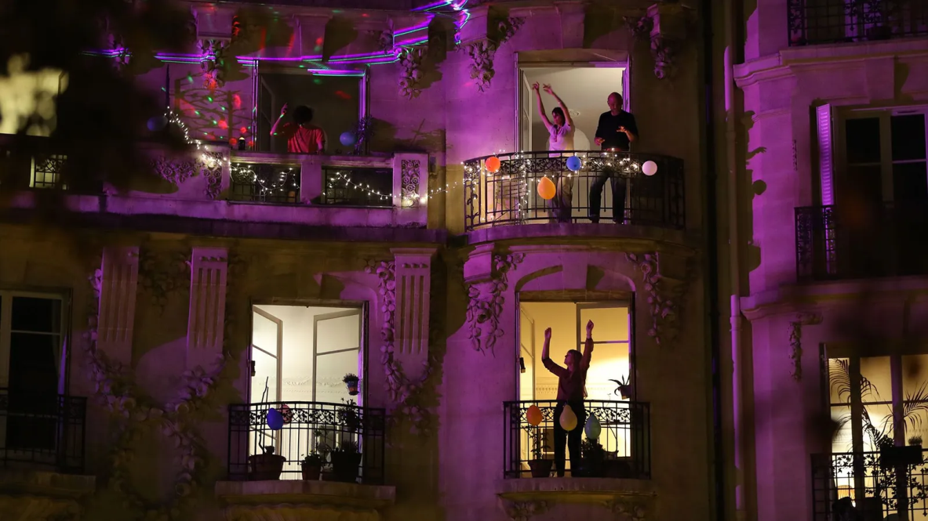
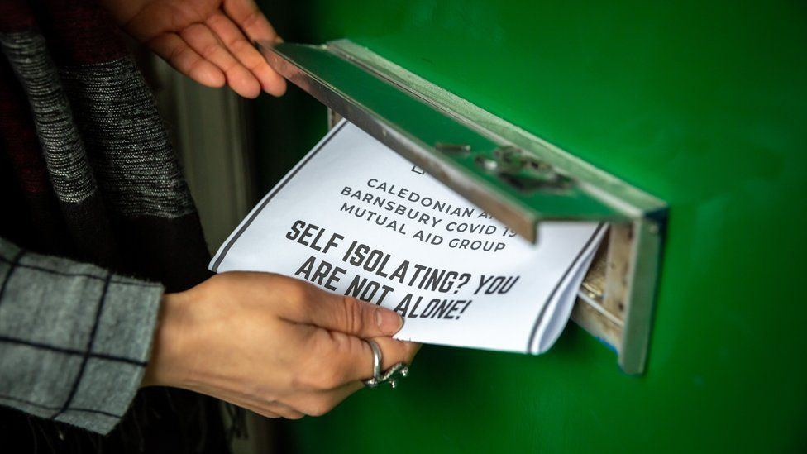
A community maintains social connections
and generates a sense of solidarity among residents
←
Joining a singing group
https://www.bbc.com/future/article/20200518-why-singing-can-make-you-feel-better-in-lockdown
→
Dropping provisions at neighbors’ doors.
https://www.bbc.com/news/stories-51979390

Slide 4
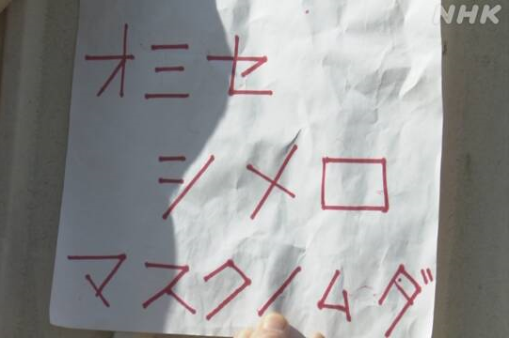
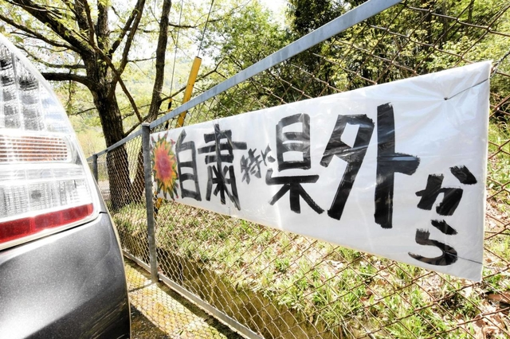
Phenomenon of “Social-distance-police” in Japan
← A sticker put on a door of a shop
“Close the shop, you are wasting masks”
https://www3.nhk.or.jp/news/html/20200519/k10012436311000.html
→
A board put on a fence at
a parking lot
“Do not come from outside our prefecture”
https://www.kobe-np.co.jp/news/sanda/202005/p1_0013315715.shtml

Slide 5
Question
Should people organize themselves to force the public to obey authorities?
Might communities become mutual surveillance agents for authorities?
Thinking by oneself & sharing with others
as one of many diverse individuals
A community is an assembly of related individuals
Participatory community development (PCD)
as a strategy against authoritarianism

Slide 6
Purpose
General PCD process
Cycle
Observe situation
Notice a problem
Set a goal
Make a plan
Start action
Achieve the goal
Check the process
Acquire community capacity
Literacy to take measures to solve the community’s problems that residents acquire through participation in PCD process
Purpose
Clarify a process by which a CDA acquired its community capacity
Clarify factors to improve its community capacity

Slide 7
Methodology
General PCD process
Cycle
Observe situation
Notice a problem
Set a goal
Make a plan
Start action
Achieve the goal
Check the process
Needs
Planning
Resource
Mobilize
Acquire community capacity
Analyzing framework
Skills to know needs
Skills to plan
Skills to get resources
Skills to mobilize residents

Slide 8
Introduction
8
Start of PCD in Taiwan
Comprehensive Community Development Policy
（社區總体營造, 1994-2001）
  Background
    Started community development in the 1950s
    Democratic reforms since the 1980s
    Weakening local communities and rising local problems
  Community Development Association (CDA, 社區發展協會)
  - Volunteer residents’ association
  - A formal PCD body based on the Civil Associations Act
  (to be established by 30 or more residents over 20 years old)

Slide 9
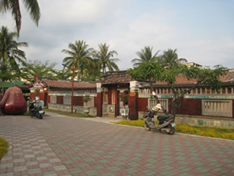
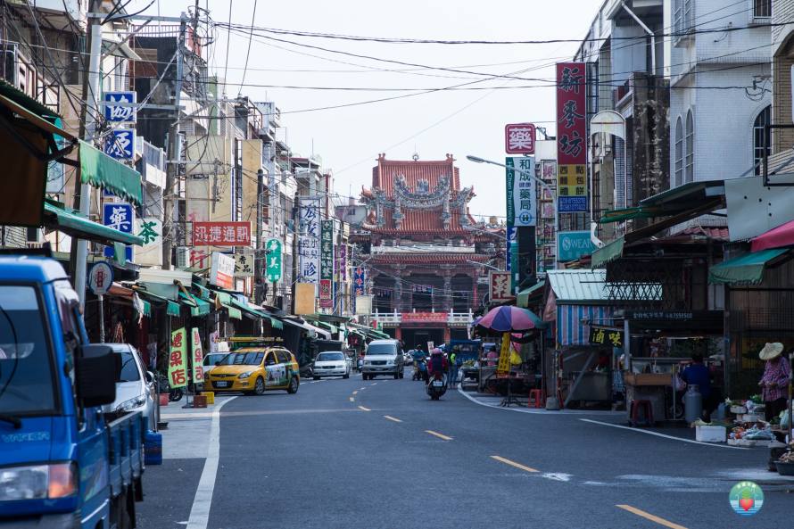
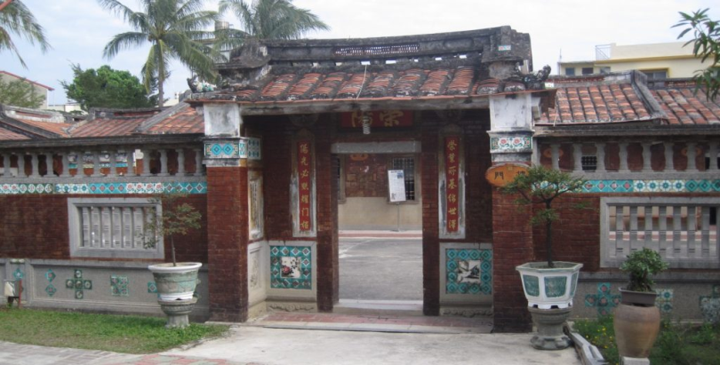
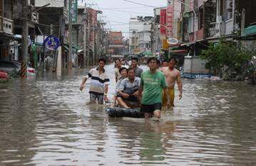
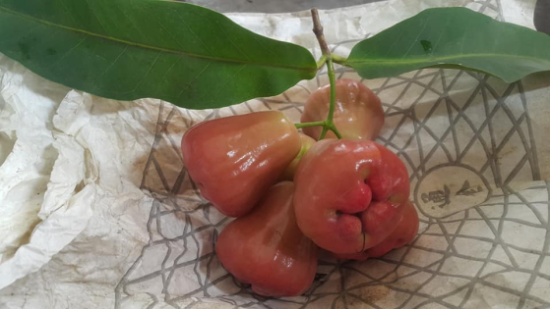
Research site
Yong-le village in Linbian township, Pingtung county
The historical site of Fuqi-gucuo
(福記古厝)
The main street of Linbian township
永樂社區發展協會 https://www.facebook.com/
環境保護局 http://61.219.150.100/ptlc/2017-06-03-06-19-36/571-2018-07-19-05-51-21
317林邊故事鄉https://www.317nb.net/
Population 3,627
The number of households
1,349
Main industry Agriculture
This village is famous for
wax apple production
https://www.cet-taiwan.org/node/592
林邊聖豐蓮https://www.facebook.com/
The 8/8 flood（8/8/2009） Wax apple

Slide 10
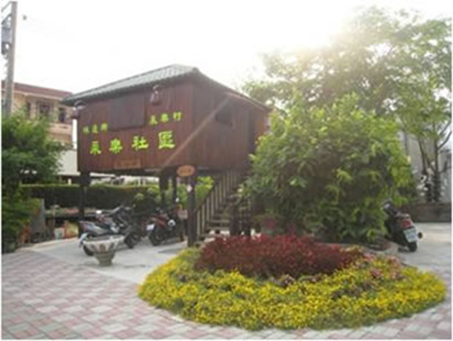
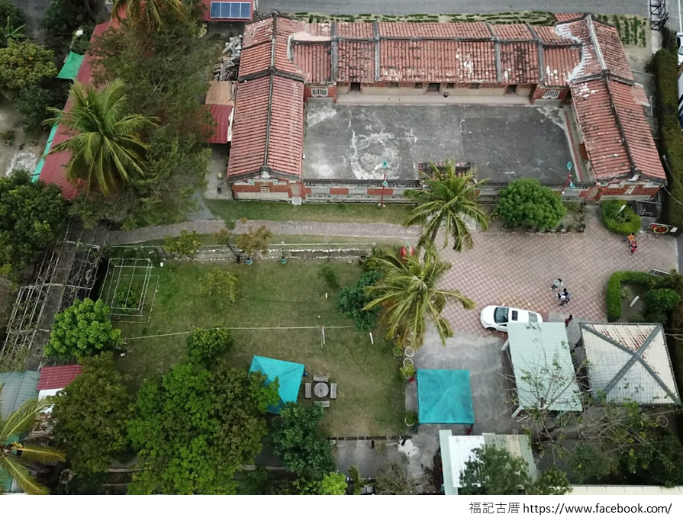
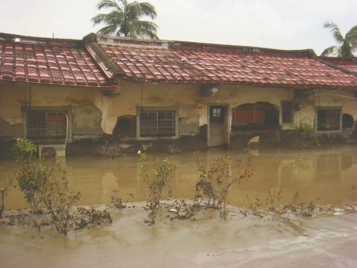
The Yong-le CDA office in the Fuqi-gucuo
（福記古厝）
I lived here during surveys
The Yong-le CDA
Established in 2001
The number of members 42 (2020)
Community activity centre
The San-he-yuan
The CDA office
Community farm
Garden
The CDA
office
https://nitechlun8ywla.pixnet.net/blog/post/47665636
A full view of the Fuqi-gucuo
The 8/8 flood（8/8/2009)

Slide 11
Outline of survey
Field survey 3 times during 2019-2020
Stay 10-20 days per survey
Interviews with PCD leaders
Mr. T (the village mayor in his 60s)
Ms. Z (the full-time worker at the CDA in her 40s)
Bibliographic survey
Community development plans and community activity
reports made by the CDA
Conversations with residents who frequently visited the Fuqi-gucuo

Slide 12
Result
PCD activities & Mr. T’s actions
The first period: 1998-2009
Year | Activity | Event, Mr. T’s thinking & action
1998 | Village cleaning | Found poor drainage channel maintenance caused floods Be elected the village mayor Organized a village cleaning group “I did not know exactly what culture was” “I want to know what I should do as much as possible…The only way for me is to learn slowly. “The drains must be open”
2001 |  | Established the Yong-le CDA Participated in a PCD study tour
2003 | The san-he-yuan renovation | Met a local environmental education activist
2004 |  | Ms. Z started her job at the CDA
2007 | PC class
2008 | The Fuqi-gucuo opens to public Farming experience | “The children were no longer familiar with rural life”
 | Book reading

Slide 13
I lived here during surveys
Community activity centre
The San-he-yuan
Community farm
The CDA
office
Garden

Slide 14
Result
PCD activities & Mr. T’s actions
The first period: 1998-2009
Year | Activity | Event, Mr. T’s thinking & action
1998 | Village cleaning | Found poor drainage channel maintenance caused floods Be elected the village mayor Organized a village cleaning group “I did not know exactly what culture was” “I want to know what I should do as much as possible…The only way for me is to learn slowly. “The drains must be open”
2001 |  | Established the Yong-le CDA Participated in a PCD study tour
2003 | The san-he-yuan renovation | Met a local environmental education activist
2004 |  | Ms. Z started her job at the CDA
2007 | PC class
2008 | The Fuqi-gucuo opens to public Farming experience | “The children were no longer familiar with rural life”
 | Book reading
The Environmental Project (the Environmental Protection Bureau)
The Cultural Preservation Project (the Council for Cultural Affairs)

Slide 15
Result
PCD activities & Mr. T’s actions
The second period: 2009-2016
Year | Activity | Event, Mr. T’s thinking & action
2009 | Book reading | The 8/8 flood
2010 | Collecting waste material | The Fuqi-gucuo completed the repair work “I do not need the government subsidy for repairs” “The idea posed by the government for disaster recovery is different from our opinions.” “Mr. T developed his concept of “keeping the village clean” to the environmental conservation activist.
 | Environmental activity project | “I became accustomed to speaking in front of people and learned how to develop activities.”
 | Disaster risk reduction
 | Distribute vegetables
2011 | Farm village staying project
2012 | Mobile library
2013 | Waste reduction
2015 | Book reading
2016 | Evacuation drill

Slide 16
Result
PCD activities & Mr. T’s actions
The third period: 2017-present
Year | Activity | Event, Mr. T’s thinking & action
2017 | Elderly care | Start the volunteer registration system
 | Jogging & drain cleaning | “I want them to know the ditch will keep us safe, therefore we must keep the ditch clean.” Participants 62
2018 | Music concert | “I wanted to let children know the area was beautiful.”
2019 | Jogging | “We do culture”
2020 | Farming experience | “Agriculture is culture” “We have many things we are able to hand down to the next generation. We have to let the next generation know about Linbian’s culture.” Jogging participants 172 Volunteer 30
The primary school adopted this activity to its curriculum

Slide 17
Verification of the CDA’s initiative
The first period: 1998-2009
The government
The Yong-le CDA
Private funding associations
<Mr. T’s speaking>
“The drains must be cleared”
“I did not know exactly what culture was”

Slide 18
Verification of the CDA’s initiative
The second period: 2009-2016
Library
The government
The Yong-le CDA
Primary school
Needs
Private funding associations
<Mr. T’s speaking>
“The idea posed by the government for disaster recovery is different from our opinions.”
Planning
<Ms. Z’s speaking>
“ I learned how to develop activities.”
Resource

Slide 19
Verification of the CDA’s initiative
The third period: 2017-present
Library
The government
The Yong-le CDA
Primary school
Private funding associations
Local expert
Participants increasing
Local expert
<Mr. T’s speaking>
Mobilize
Local expert
“We must keep the ditch clean.”
“We do culture”
“We have many things we are able to hand down to the next generation.
To invite as a lecturer for the elderly care activity

Slide 20
Conclusion of this case
A process by which a CDA acquired its community capacity
  = a process the CDA becomes confident
  = a process the CDA finds the value of the community
Factors to improve its community capacity
  Balanced relationship among the CDA executives
  Leader sticks to its key concept and the PCD venue
  Conduct accessible activity based on the key concept,
  in other words, correctly using resources according to
  its needs.

