Slide 1
Voicing Taiwan: The formation of the Imaginary “Locality” and Taiwan Identity in “Singing Taiwanese”
Kuangtze Yang 楊廣澤
Center for World Music in University of Hildesheim

Slide 2
Taiwanese songs and the "New Taiwanese Song Movement"
Taiwanese Songs: An unique musical and social phenomenon which belongs to Taiwan society
the "New Taiwanese Song" Movement
    The emergence of the "New Taiwanese Song" Movement
    The original ideas:
    (1) Emphasis on the use of mother tongue in music creation
    (2) Hope to break the mainstream values and the restrictions represented by the creation in Mandarin at that time
    (3) Seeking the new musical styles to counter the Japanese “Enka” style that dominated Taiwanese pop songs at the time
    The Changes and development after 2000
    Still emphasizing on mother tongue (Taiwanese) creation, but gradually appearing different basic attitudes and reasons
    The streams of musical styles are more diverse, resulting in a complex, diverse and fuzzy overall appearance.
    The greatest commonality in style: Oppose the mainstream of Taiwanese pop songs that is influenced by ``Enka'' and ``karaoke style''

Slide 3


Slide 4
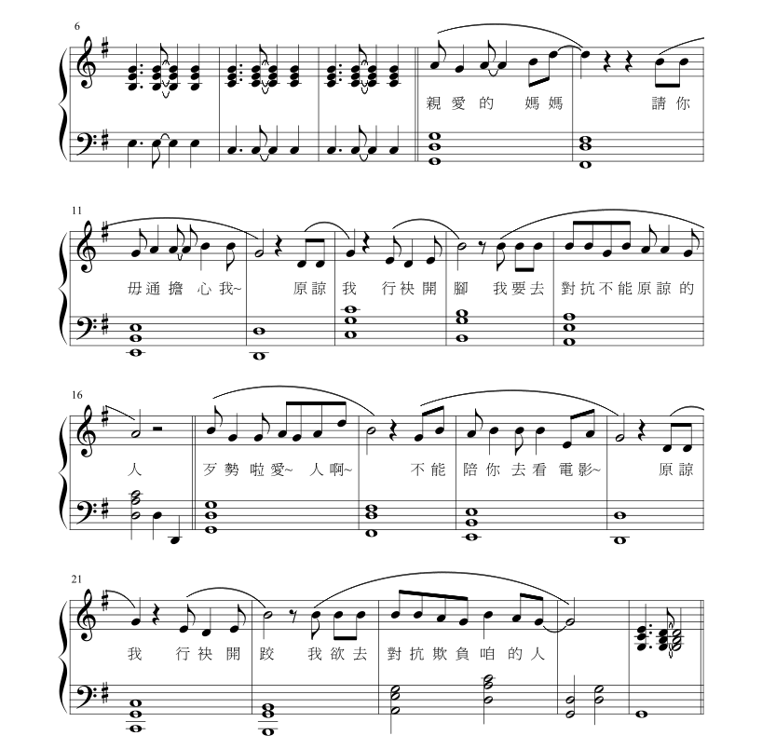

Slide 5
What we found in the above case:
Young generations’ consideration and strategy for voicing in Taiwanese(including speaking and singing) : Several common attitudes and phenomenon found in my fieldwork and interviews.
Taiwanese as a metaphor, a symbol of the nostalgia about the premodern period(voicing in Taiwanese as some kind of cultural performance), and “speaking/singing in Taiwanese” as an act for demonstrating identity(voicing in Taiwanese as a performative action), these two are mutually causal.

Slide 6
The research hypothesis and research questions
Three basic hypothesis:
  Taiwanese songs are an important representation of the imaginary “musical locality" of Taiwan in contemporary Taiwan society.
  The vocal style of "singing Taiwanese" is the key factor on shaping this imaginary " musical locality ".
  All the changes in singing style actually express both the Taiwan identity and the nostalgia about the pre-modern period, which are different from the past and unique to this generation.
The research questions with two study perspectives:
  With regarding “singing Taiwanese" as a cultural performance, to interpret the nostalgia it expresses and the imagination of “the localness” of Taiwan it forms.
  With regarding “singing Taiwanese" as some kind of “performative action”, to explore how the Taiwan identity shaped through its practice.

Slide 7
Why should we focus on “singing” instead of “song”?
Taiwanese songs are one of the most important representations of the “musical locality" of Taiwan, and the vocal style of "singing in Taiwanese" is the crucial factor on shaping this imaginary " musical locality"
The reflections and revision toward the methodology both of studying vocal music and voice study in the academic field.
  Reflection and criticism of the "Voice Forgotteness" hypothesis in traditional musicology research
  The subsequent influence from the perspective of musical-cultural identity on vocal music research
  In the original field of performance action/utterance research, there is a lack of specific methods for analyzing voice and vocal Music.

Slide 8
Three Key Aspects behind the Research:
The social significance and the cultural meaning of “Voicing in Taiwanese" – including "speaking in Taiwanese" and "singing in Taiwanese " – in the contemporary social context of Taiwan.
The method about how to describe and analyze the vocal style of singing in Taiwanese when treating singing as a performative action.
The construction of the imaginary musical locality and the formation of Taiwan identity with "singing in Taiwanese "

Slide 9
Reference
洪惟仁。2019。《台灣社會語言地理學研究：台灣語言的分類與分區》。台北市：前衛出版。
連金發
2018a.〈早期閩南語戲文中「句」的語意詮釋：語意延伸和語用推論〉
(Interpretation of “ju” in early Southern Min texts : semantic extension and pragmatic infererence).
《清華學報》Tsing Hua Jouranl of Chinese Studies 48.1. : 113-141. (NSC 102-2923-H-007-001), March.
2018b. Flavors of phah⁴ “拍”: semantics-syntax interface.
The 26th Annual Conference of International Association of Chinese Linguistgics (IACL-26),
Department of Asian Languages and Culture and Center for East Asian Studies, University of Wisconsin-Madison,
May 4-6, 2018. Keynote speech (MOST 105-2410-H-007-043)
2020. (In press) The polyfunctional na⁷/na² “那” in Early Southern Min and its Later Developments. Journal of Chinese Linguistics.
Bohlman, Philip V.
1999. "Ontologies of Music." In Rethinking Music, edited by Nicholas Cook and Mark Everist, 17-34. Oxford: Oxford University Press.
2000. "The Remembrance of Things Past: Music, Race, and the End of History in Modern Europe.
" In Music and the Racial Imagination, edited by Ronald Radano and Philip V. Bohlman, 644-676. Chicago: Chicago University Press.
Stoke, Martin. 1994. ‘Introduction: Ethnicity, Identity, and Music’. In Ethnicity, Identity and Music, edited by Martin Stoke, 1-27. New York: Berg Publishers.

